Slide 1
Contents
What is an individual project?
What academic support are you given?
How did you decide on a project?
What is your project about?
What do you hope to achieve by the end?
Are there particular modules that have fed into your project?
How is it currently progressing?
What challenges are you facing?
What do you have to produce by the end?
If successful what impact could your project have?

Slide 2
Final Year Project
PCSW Presentation

Slide 3
Parallel Programming Tools for Exploring Immune System Development
Notes:
Lets take these in turn (but backwards)…

Slide 4
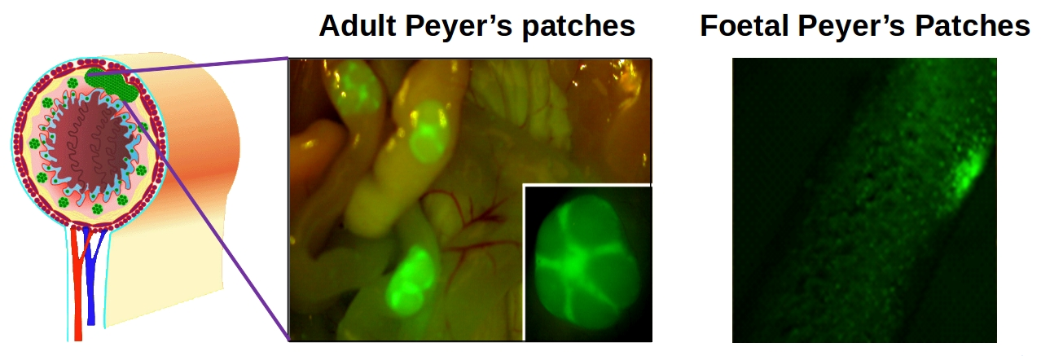
Background
Peyer’s Patches develop in the gut
An existing simulation models this
Notes:
Peyer’s Patches are clusters of lymphoid cells which are an essential part of the immune system
12h before birth, until about 48 after..? – is this 100% correct?
PPSim is an existing simulation that was created to explore the development of clusters of lymphoid cells in the gut.

Slide 5
What is it about?
Peyer’s Patch SIM
Agent Based Modelling
Parallel Programming Task
Notes:
That’s the background, but..
If we add some abstraction into the mix (every programmer’s dream):
At the top level, it’s work on a simulation of Peyer’s Patch’s that helps further biological understanding
As a computer science project, it’s an Agent Based Modelling implementation
This simulation already exists
For statistical tests and full analysis, the simulation takes around 3 month to run
ABM lends itself well to parallelism because each agent can run separately apart from interaction
So for me in particular, it’s primarily a parallel programming task, as I’ve been given an (all-but) correct platform model

Slide 6
Research
Research into Biological Modeling
Prevalence
YCIL Papers
Others…
Research into Parallelism
Previous York Projects
Hardware Documentation
Papers & FlameGPU
Notes:
Aiming to build up a justification for any work
PPSIM works already!
Want to be able to work towards generalising any optimisations and cell interactions that might be useful for other models
Increasingly popular for many forms of work, including genome modelling, and cell dynamics which is the focus here
Talk about original project brief
What has changed?
What hasn’t?

Slide 7
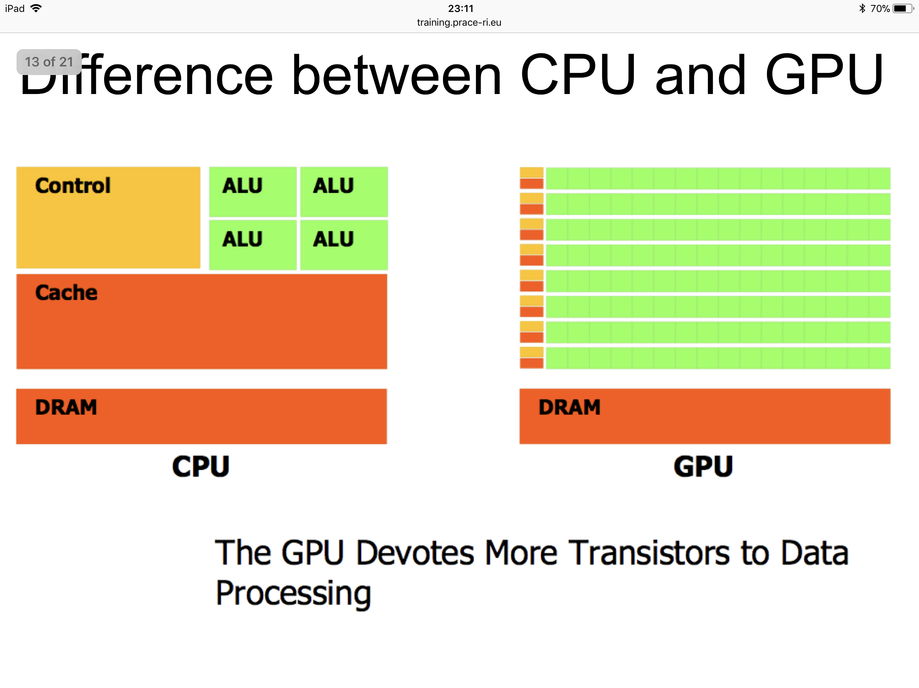
Program Parallelisation
CPU
GPU
1-8 Cores
2500+ Cores
Notes:
Two great ways of parallelism on a single PC
Central Processing Unit
Every PC has them
Easy to parallelise, just perform different runs in parallel for statistical analysis
But not as fast
Graphics Processing Unit
Significantly faster for basic tasks- number crunching
But each agent is performing similar actions in each turn..!

Slide 8

Implementation
Exploring Hardware
CPU vs GPU
OpenCL vs CUDA
Custom Code vs FlameGPU
Notes:
Talk about difficulty accessing hardware:
Compare solutions:
CPU vs GPU
YARCC access + training
Not ideal for development
Development PC coming soon
OpenCL vs CUDA
OpenCL runs on GPUs from multiple vendors but must be tailored to each piece of hardware
Limited literature comparison but general consensus:
Better library support (CUDA)
CuRand – parallel random number generator
Easier to setup (CUDA)
CUDA vs FlameGPU
FlameGPU uses X-Machines, similar to an FSA but with memory
CUDA is obviously going to be the fastest as its developed for controlling the hardware directly with no abstraction
BUT FINDINGS MUST BE GENERALISABLE- we don’t NEED this particular simulation to run faster but general findings will be useful
Custom code will likely be more tailored to the specific solution!

Slide 9
Ideal Results
Generalising findings to other models
Build on FLAME GPU
Notes:
Attempt to compare to original SIM to calculate significance of any performance improvements
FLAME GPU is notoriously complicated to get to grips with and this has been a struggle.
A lot of powerful tools are, by definition, complicated as they offer plenty of features.
I believe the next step for FLAME is to provide to tool to allow non-technical/biological users to access power through some form of FLEXIBLE MODELLING tool- R. PAIGE

Slide 10
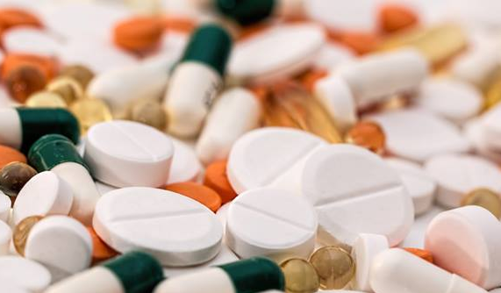
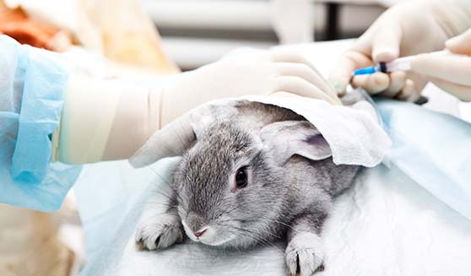
Impact
Generally
$2.5bn R&D cost per drug
Reduction in Animal Testing
PPSIM so far
New knowledge of the immune system
Worked with labs to prove this in Vitro
Notes:
Faster and easier simulations is the end goal
Obviously there’s a lot of scope within biology for simulations to help with testing.
Ideally want to make simulations far faster and easier than animal testing
Clearly more ethical
So far it’s been used to gain a greater understanding of Peyer’s Patch formation.
Further understanding means we could trigger a faster immune response to pathogens
Impact of work has gone to three pharmaceutical firms and one cosmetic firm

Slide 11
Any Questions?

